Slide 1



Team-Chargers
12
Sravanthi Kadari – Team leader
Data Analysis
Chaitanya – Data Preprocessing and Data Modeling, Training
Janani –Testing and Deployment and Application

Slide 2

House Price Forecast
A prediction for house prices is made using the dataset from the Kaggle House Prices - Advanced Regression Techniques.

Slide 3
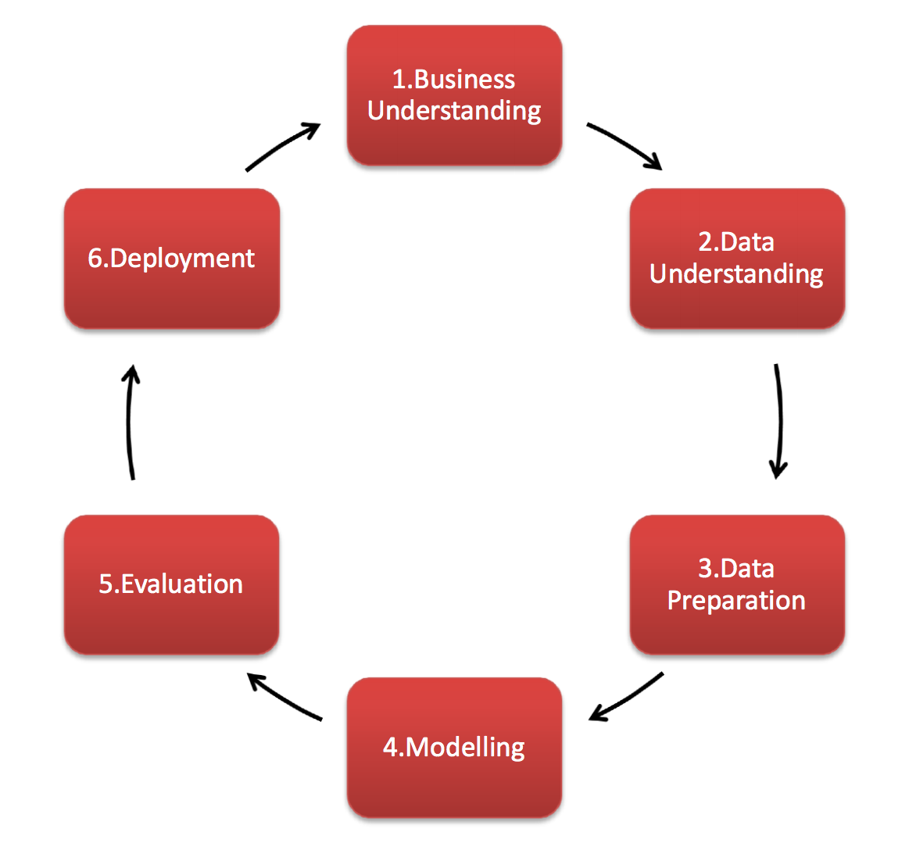
CRISP DM Methodology.

Slide 4

Business Objective:
This project's main objective is to combine data visualization and model building to accurately predict home values using a dataset from a Kaggle competition.

Slide 5

Business Understanding
From a business perspective, if a buyer can predict the price ranges of the residences in a particular area, he may be able to organize and prioritize his wants and get a better price.
We may, for instance, inquire what price a buyer would be willing to pay for a house with three bedrooms, two bathrooms, a basement garage, and a preference for a two-story, vintage building from the late 1980s.

Slide 6

Data Source/ Data Aquisition
The House Pricing data set was obtained from Kaggle.
The collection contains over 1400 records of home sales in Ames between 1872 and 2010.

Slide 7

Data Understanding
The data includes the following fields.
OverallQual: Overall quality of the house
GrLivArea: Above grade (ground) living area square feet
GarageCars: Number of garage cars
FullBath: Number of full baths
YearBuilt: Year house was built
TotRmsAbvGrd: Total number of rooms above grade (excluding bathrooms and closets)
Fireplaces: Number of fireplaces
BedroomAbvGr: Number of bedrooms above grade
GarageYrBlt: Year garage was built

Slide 8
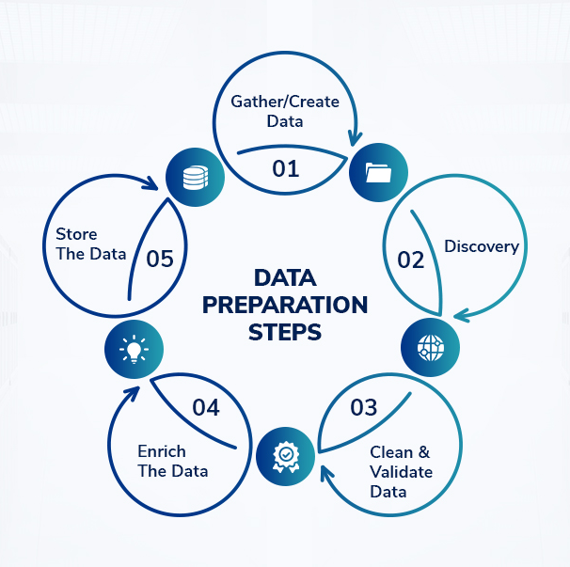
DATA PREPARATION
In order to prevent the adoption of soiled data, we must clean our data and maintain it in a ready-to-use format. The actions are as follows:
Exploring the data
Data cleaning for missing values and outliners detection -
There are many outliers. The distribution is like a normal distribution. The feature is target value. Because of it we will not make changing.
Formatting of numeric data fields in the datasets
Feature Selection and Correlation Analysis -
For House Price Prediction we had use features that have correlation with “Sale Price” by heatmap
Data Visualization and Exploratory Data Analysis
Filling the missing values by examining the graphics.
Impute missing values

Slide 9

Modeling
It is well-known for its:
To model our data, we use the LightGBM algorithm.
It is a gradient boosting framework that uses tree-based learning algorithms.
Faster training speed and higher efficiency.
Lower memory usage.
Better accuracy.
Support of parallel and GPU learning.
Capable of handling large-scale data.

Slide 10
Thank you

